Slide 1

Sequence Alignment Using Needleman Wunsch Algorithm to Study Microgravity Effects on PBMCs
Cedric Briones
CS123A

Slide 2
Goal
Implement the Needleman-Wunsch algorithm in Python
Align RNA-Seq reads from the Ground and Microgravity conditions from the OSD-689 NASA GeneLab study
Output a similarity score between the two samples’ first 150 sequences

Slide 3

OSD-689: June 11, 2024
Researchers used single-cell RNA sequencing of human peripheral blood mononuclear cells (PBMCs) exposed to simulated microgravity for 25 hours.
The results showed that microgravity alters important immune pathways and overall immune cell function.
In this project, I applied the Needleman-Wunsch global alignment algorithm to compare the first 150 RNA-sequences from the Ground and Microgravity samples to measure the similarity between the sequences.

Slide 4
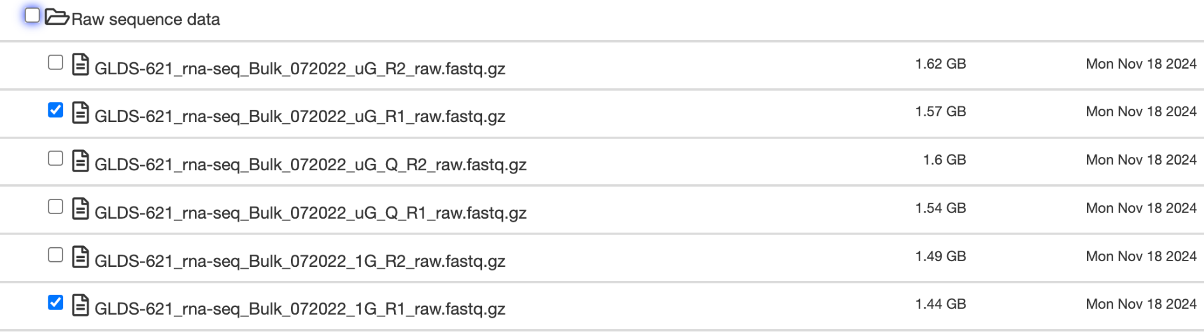
Samples I chose
Ground Sample: GLDS-621_rna-seq_Bulk_072022_1G_R1_raw.fastq
Microgravity Sample: GLDS-621_rna-seq_Bulk_072022_uG_R1_raw.fastq
1G = Cells grown in normal Earth gravity conditions
uG = Cells exposed to simulated microgravity for 25 hours

Slide 5
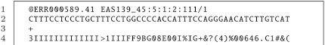
Reading From FASTQ Files
Each read in a FASTQ file takes 4 lines:
Line 1: @SEQ_ID (sequence header)
Line 2: actual RNA sequence
Line 3: + (separator)
Line 4: quality score string

Slide 6
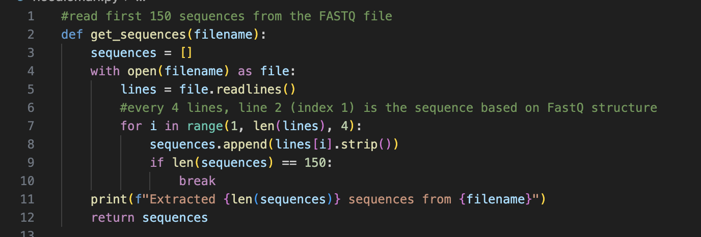
Code For Reading From FASTQ Files

Slide 7
Quick Recap: Needleman-Wunsch Algorithm
Finds the optimal alignment between two sequences
Initialization:
Create a matrix with rows equal to one sequence and columns equal the other sequence.
Fill the first row and first column with gap penalties (each move costs a gap penalty).
Scoring:
Match +1
Mismatch -1
Gap -2

Slide 8
Quick Recap: Needleman-Wunsch Algorithm
Matrix Filling:
At each cell, compute three possible scores:
Diagonal move (match or mismatch),
Up move (gap in sequence 2),
Left move (gap in sequence 1).
Choose the highest score and place it in the cell.
The final alignment score is found at the bottom right corner after the matrix is filled

Slide 9
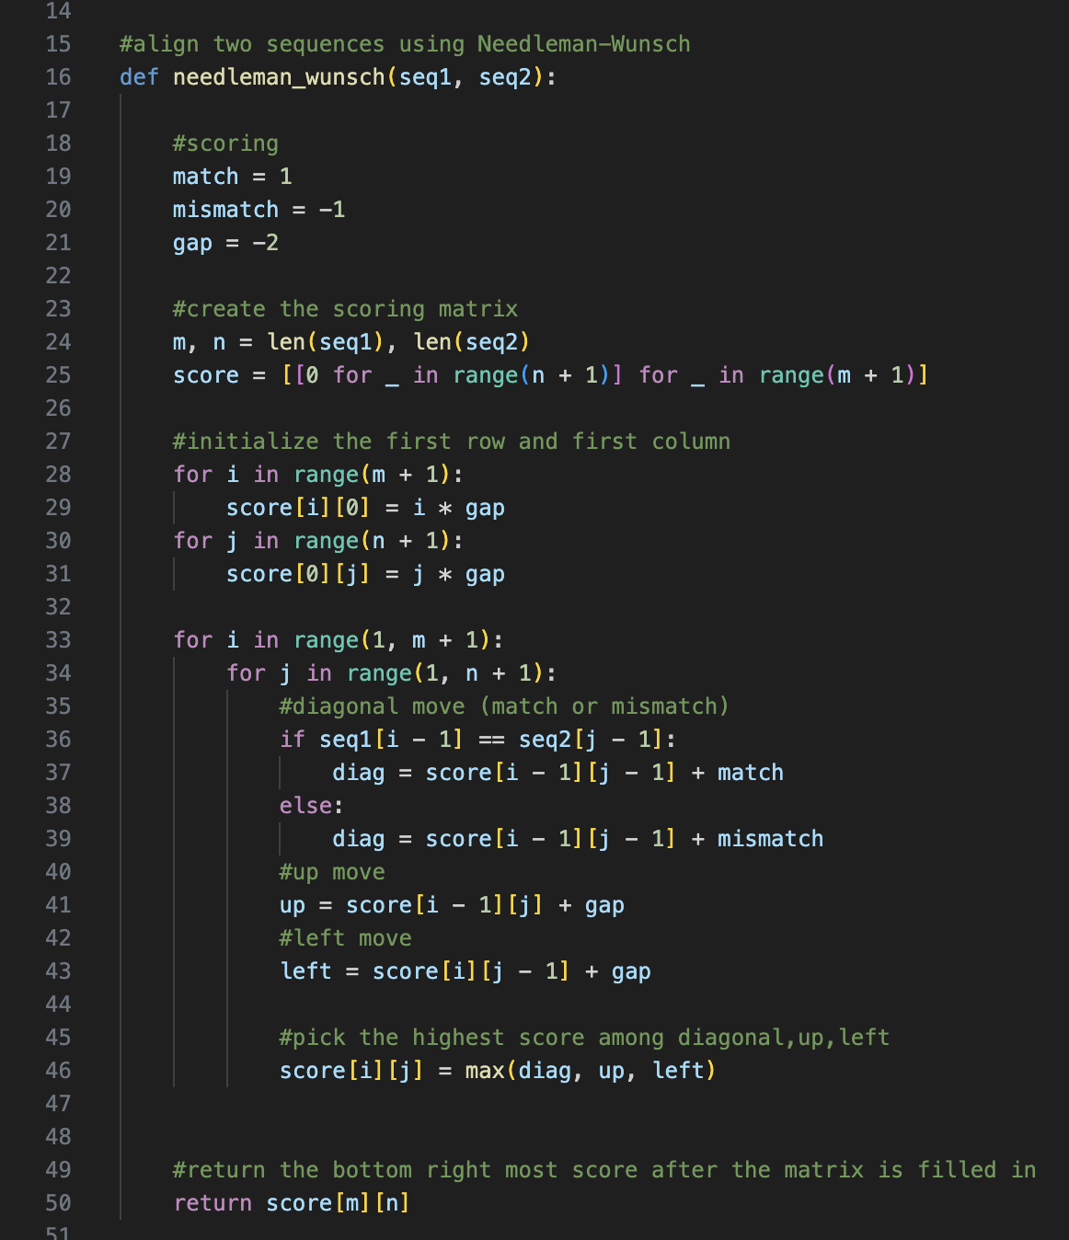
Code For Needleman-Wunsch Algorithm

Slide 10
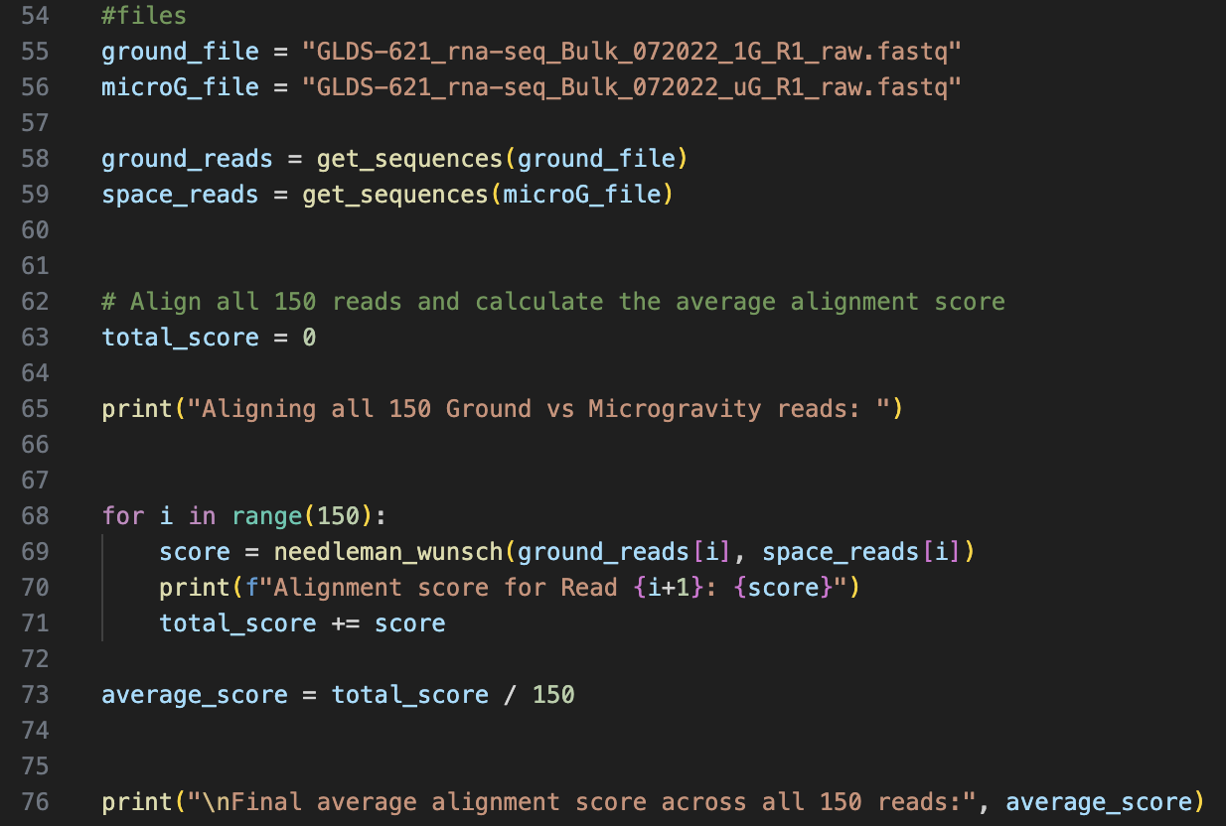
Code For Needleman-Wunsch Algorithm

Slide 11
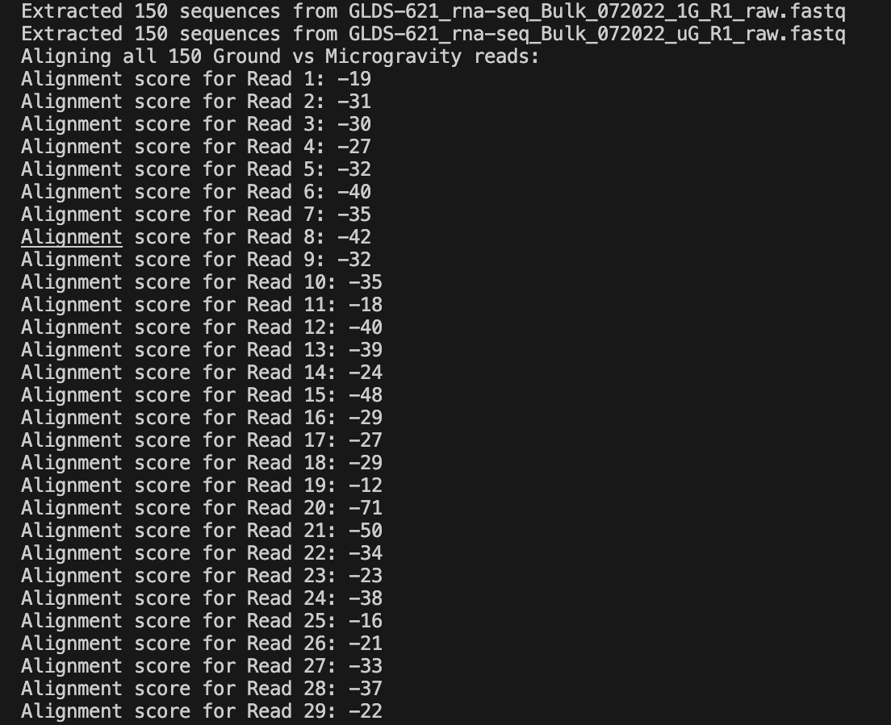
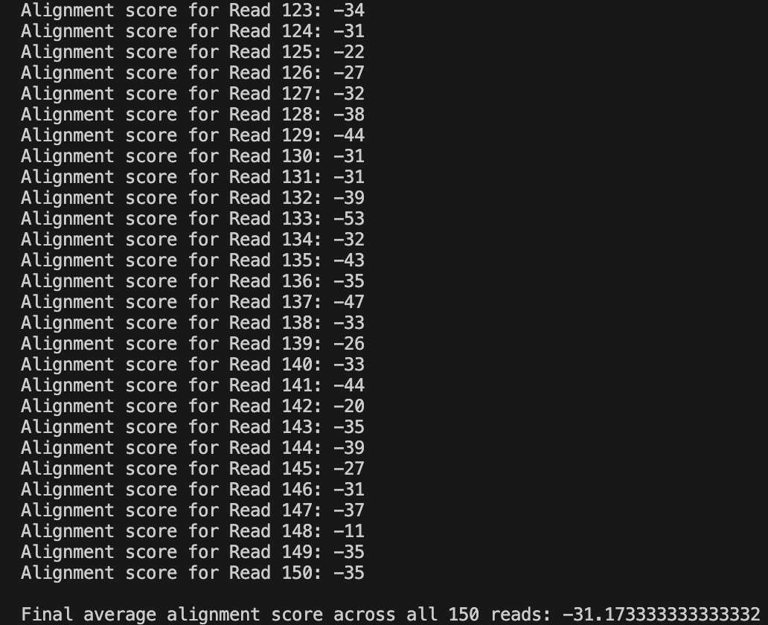
Results

Slide 12
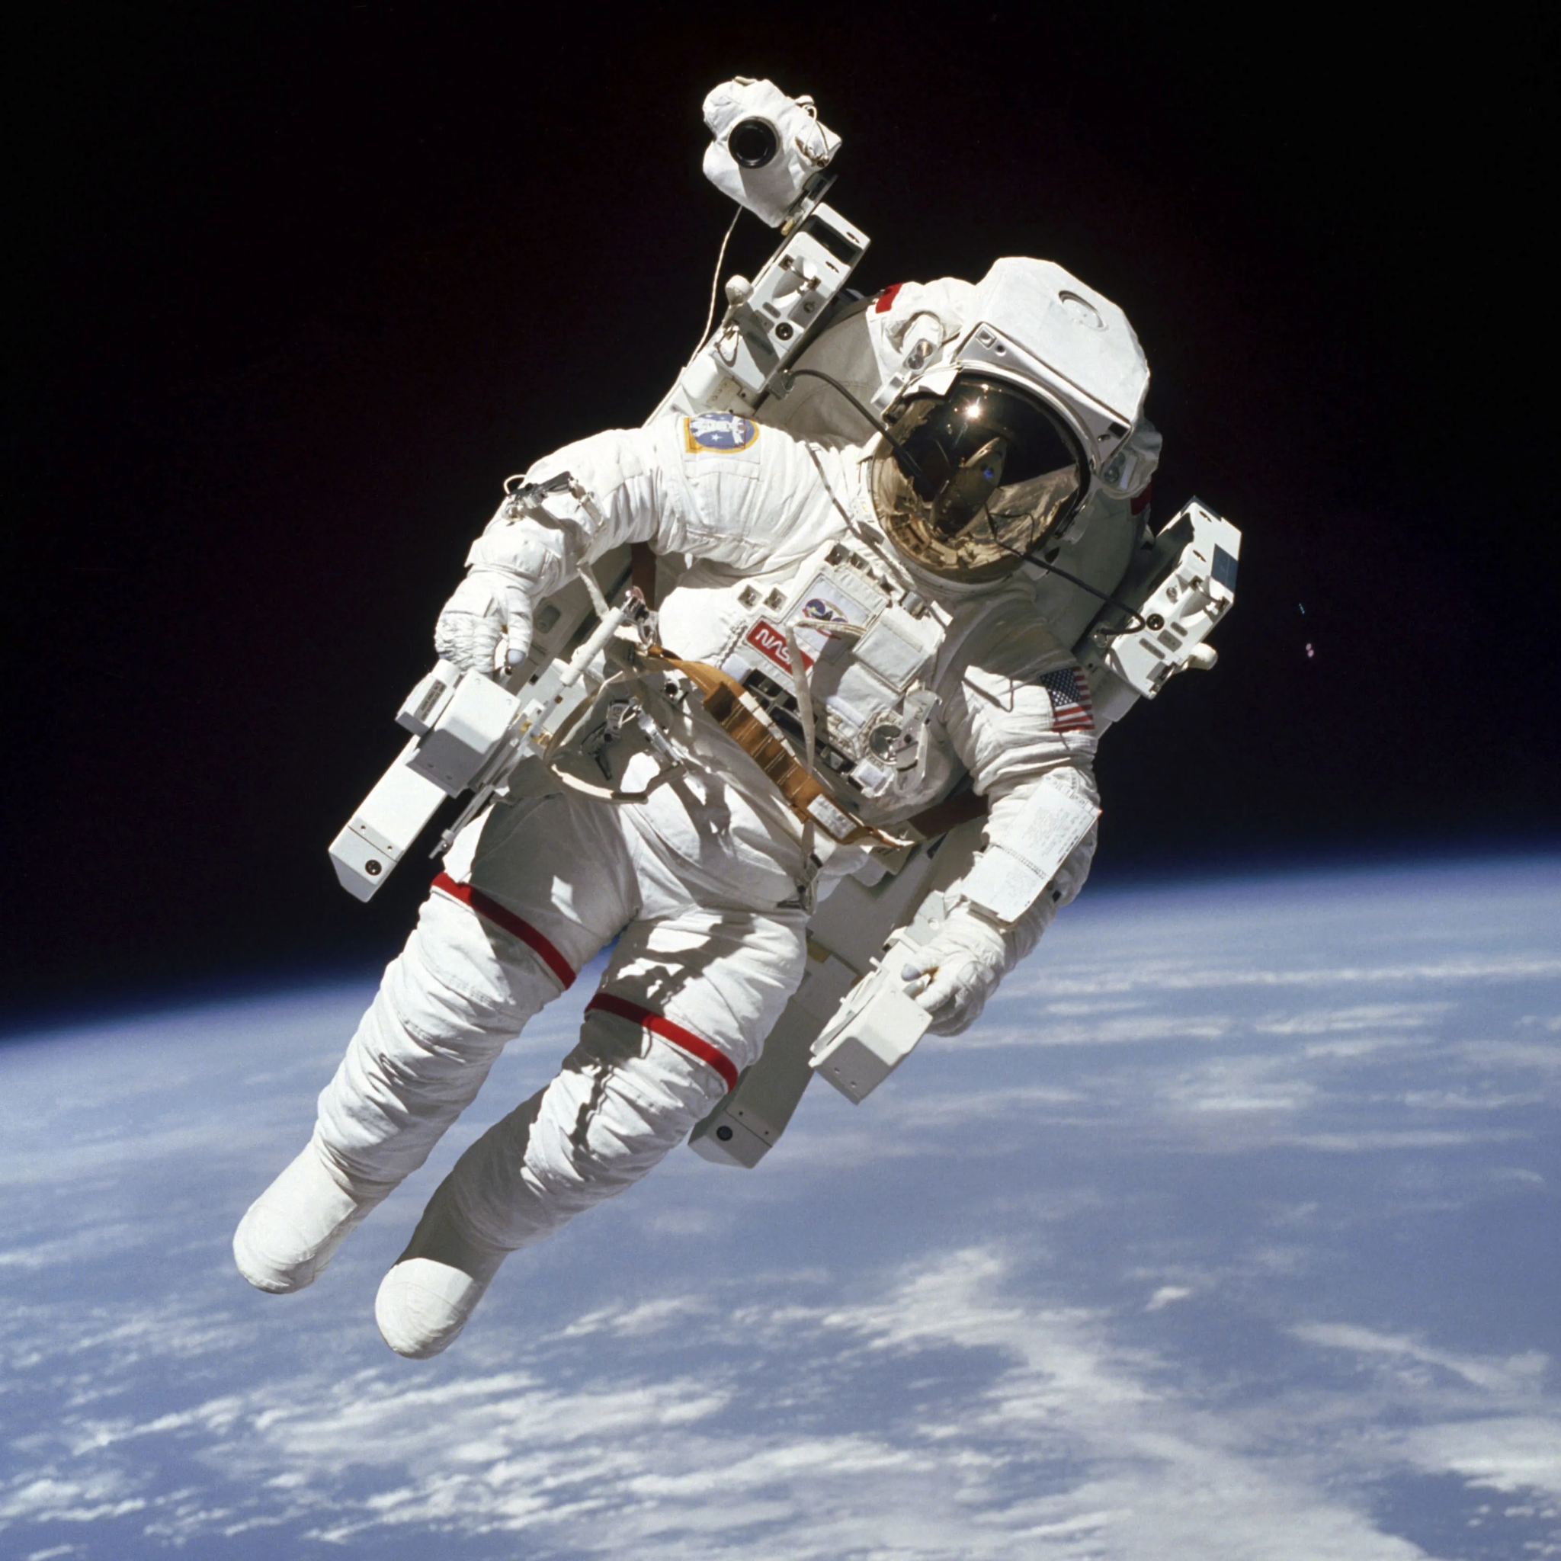
Results
The first 150 pairs had an average global alignment score of -31.17333
This negative score indicates that, on average, there are more mismatches and gaps than matches between the sequences.
This result could support the hypothesis that microgravity induces genetic expression changes

Slide 13

Struggles I faced
I was unsure of how much of the sequences to use since it contained so much.
I struggled looking for the correct files to use from the NASA OSDR website

Slide 14
Conclusion
The Needleman-Wunsch algorithm was used to align 150 RNA sequence reads from Ground and Microgravity samples from the OSD-689 to assess sequence similarity.
The average global alignment score was –31.17, which is consistent with biological expectations, as microgravity is known to alter immune cell gene expression.
However, we need to keep in mind that aligning only 150 sequences represents a very small fraction of the total dataset (approx. 20.9 million reads), and may not fully capture overall similarity.

Slide 15
GitHub
https://github.com/cedricJB07/CS123A-Final-Project/tree/main

